Slide 1
RETAIL PRICE
GROUP 19

Slide 2
Group Members
Abhishek, 2001ME02
Abhishek Verma, 2001ME04
Ansh Saxena, 2001ME10
Sakshi Yadav, 2001ME65
Veer Bahadur Singh, 2001ME80
Vipin Kumar Dhakad, 2001ME81

Slide 3
Index
Data Collection
Data Pre-processing and Cleaning
Data Visualization
Data Statistics
Hypothesis Testing

Slide 4
Data Collection
Data collection is a systematic process of gathering observations or measurements.
Source: https://www.kaggle.com/kk9969/retail-prices-of-commodities-in-india
The Dataset contains the retail prices of commodities, weekly and monthly and further divided into food and non-food categories across different states of India.

Slide 5
Data Pre-processing and Cleaning
Manipulating or dropping data before it is used in order to ensure or enhance performance.
We have done the following things:
Dropping unnecessary rows in a Data Frame
Changing the index of a Data Frame Using .str() methods to clean rows
Using the DataFrame.applymap() function to clean the entire dataset, element-wise
Renaming columns to a more recognizable set of labels
Skipping unnecessary rows in a CSV file

Slide 6
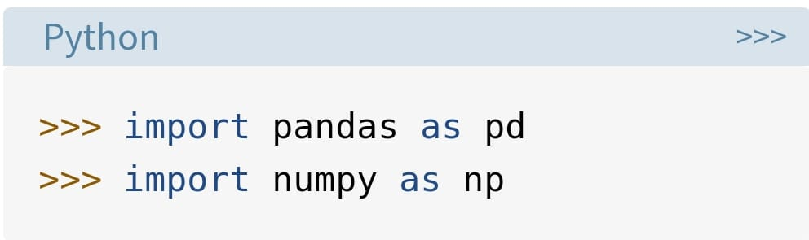
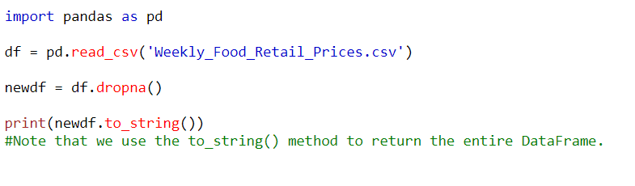
Importing libraries as shown below:

Slide 7
The dropna() method removes the rows that contains NULL values.
The dropna() method returns a new Data Frame object unless the inplace parameter is set to True, in that case the dropna() method does the removing in the original Data Frame instead.

Slide 8
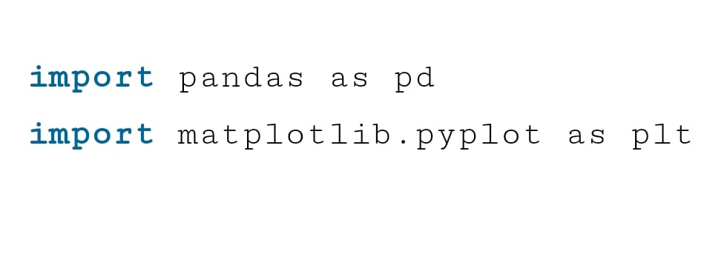
Data Visualisation
Data visualization is an interdisciplinary field that deals with the graphic representation of data. It is a particularly efficient way of communicating when the data is numerous as for example a time series
We used Matplotlib library for plotting the graph.

Slide 9

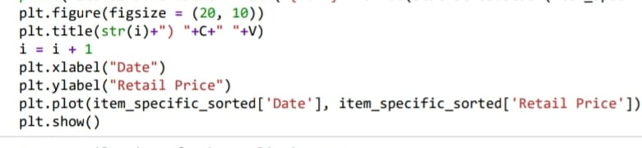
Conversion of Date format from string to object type for sorting purpose.
Library Used:
  from datetime import datetime

Slide 10
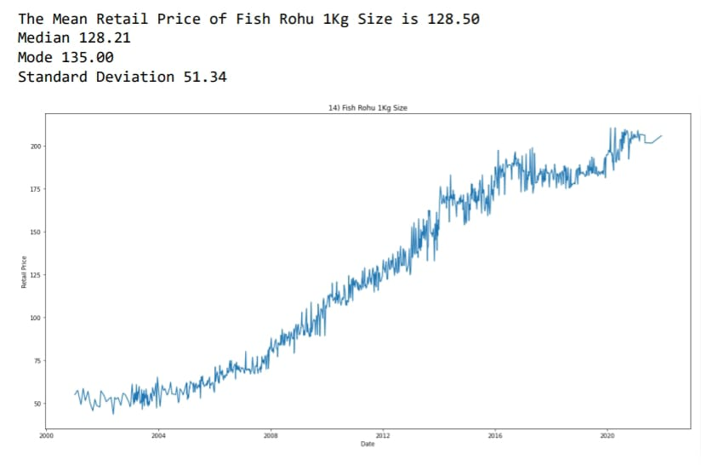
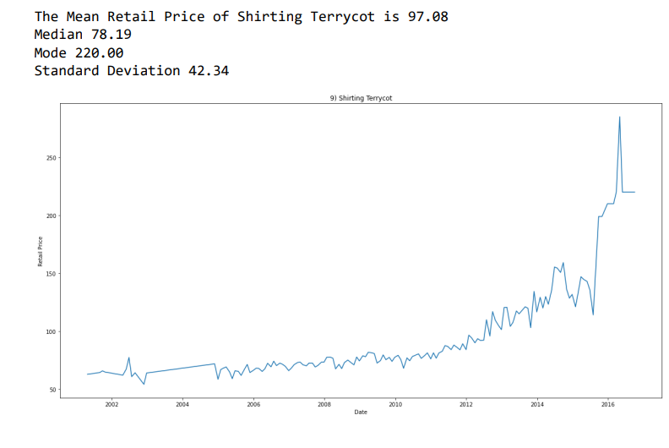

Slide 11
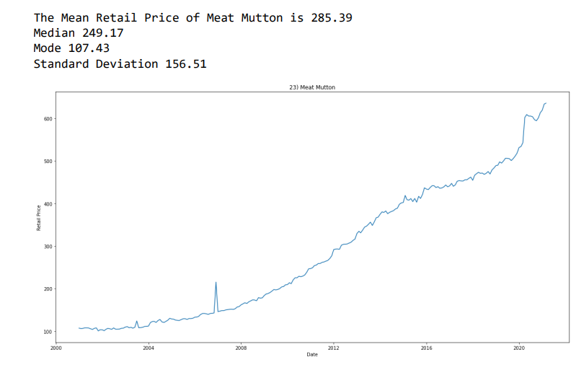

Slide 12
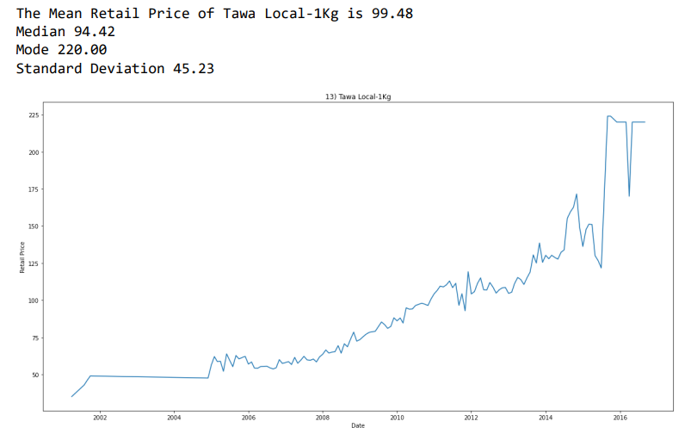

Slide 13
Data Statistics
statistics.mean(data)
  Return the sample arithmetic mean of data which can be a sequence or iterable. The arithmetic mean is the sum of the data divided by the number of data points. It is commonly called “the average”, although it is only one of many different mathematical averages. It is a measure of the central location of the data.
Libraries Used:
  import statistics

Slide 14
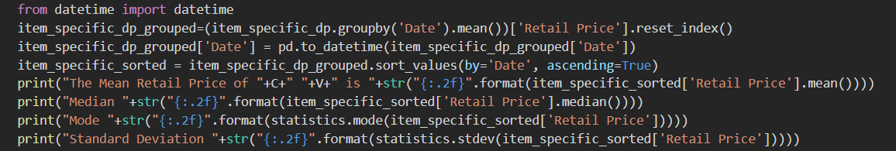
Mean:
  data_frame[‘Retail Price’].mean()
Median:
  data_frame[‘Retail Price’].median()
Mode:
  statistics.mode(data_frame[‘Retail Price’])

Slide 15
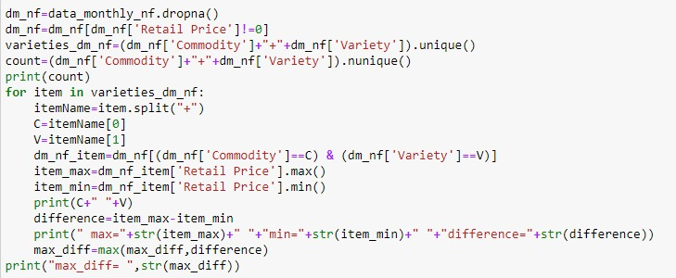
Answering some interesting Questions
Which commodity had the highest increase in the retail price?
For food:
Cumin Seeds (common)
For non-food
  Chappal (Rubber Bata)

Slide 17
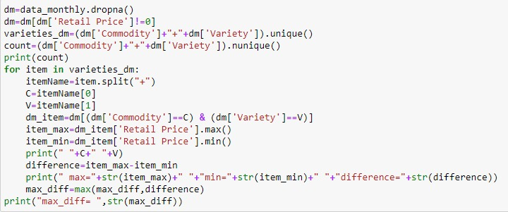
Which commodity’s price changed the least since 2001?
For food:
Salt packet (iodised)
For non-food:
  Bathing soap (hamam)

Slide 18
Hypothesis Testing
Hypothesis testing is a statistical method that is used in making statistical decisions using experimental data. Hypothesis Testing is basically an assumption that we make about the population parameter.
Hypothesis testing is an essential procedure in statistics. A hypothesis test evaluates two mutually exclusive statements about a population to determine which statement is best supported by the sample data. When we say that a finding is statistically significant, it’s thanks to a hypothesis test.

Slide 19
Null hypothesis :-
  In inferential statistics, the null hypothesis is a general statement or default position that there is no relationship between two measured phenomena, or no association among groups.
Alternative hypothesis :-
  The alternative hypothesis is the hypothesis used in hypothesis testing that is contrary to the null hypothesis. It is usually taken to be that the observations are the result of a real effect.
Libraries Used:
  scipy.stats as stats
  math
  statsmodels.api as sm

Slide 20
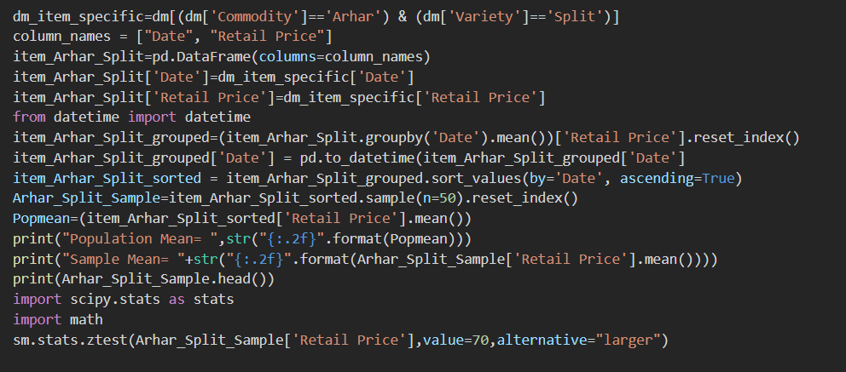
Hypothesis Testing for ‘Arhar-Split’ from Monthly dataset
Null Hypothesis:
  The average Retail Price of Commodity "Arhar Split" is 70.
Alternate Hypothesis:
  The average Retail Price of Arhar Split is greater than 70.

Slide 21
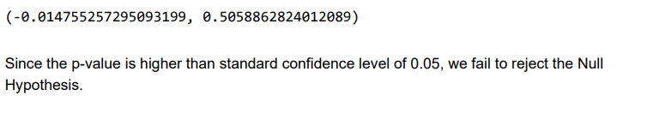
Hypothesis Testing for ‘Ragi-FAQ’ from Monthly dataset
Null Hypothesis:
  The average Retail Price of Commodity "Ragi FAQ" is 20.
Alternate Hypothesis:
  The average Retail Price of Ragi FAQ is greater than 20.

Slide 22
